Slide 1
Doing a lit review
Dr. Carroll | COM 415

Slide 2
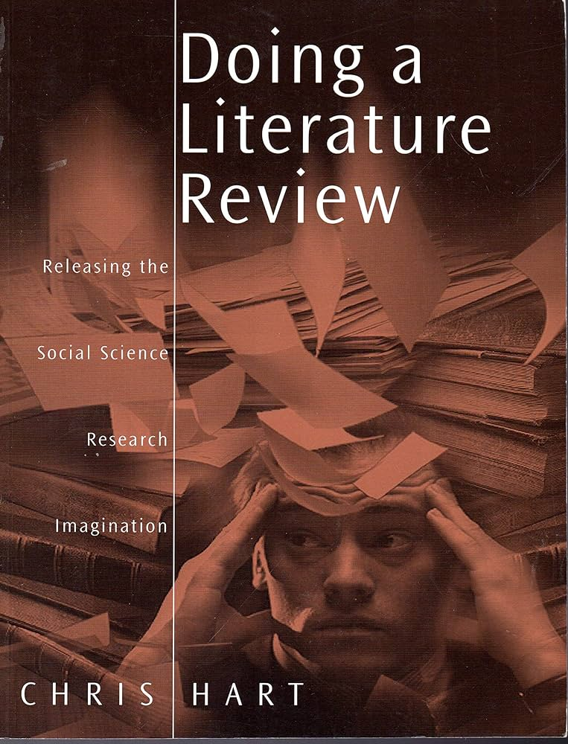
Source
Chris Hart, Doing a Literature Review (London: Sage Publications, 2000)

Slide 3
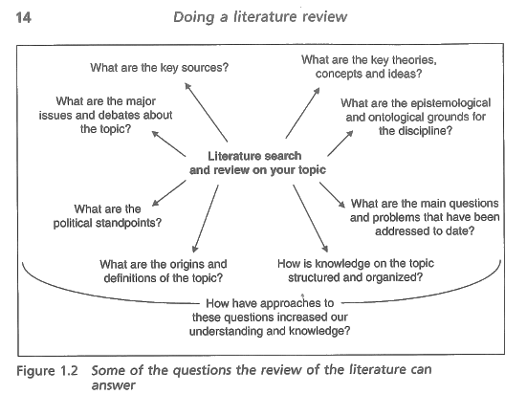

Slide 5
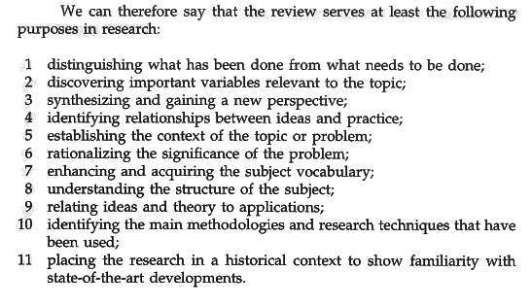

Slide 6
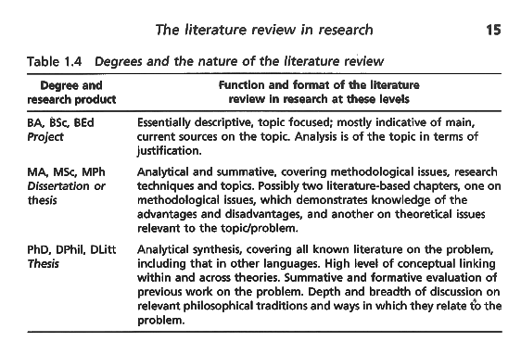

Slide 7
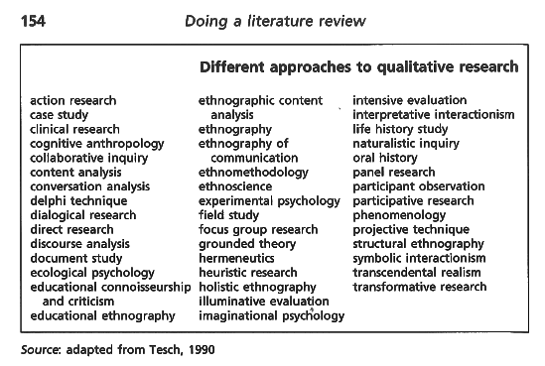

Slide 8
