Slide 1
Agenda Setting
COM 415, Dr. Carroll

Slide 2
Priming Theory
Predecessor to agenda setting
Based on cognitive psychology concept of priming
We make decisions based on preconceptions already stored in our memory
Preconceptions act as frame of reference
Priming enhances effects of media by providing audience with standards and frames of reference
Media primes audiences by creating frames of references (ex. what a credible person looks like, what news looks like, etc.)

Slide 3
How Priming Works
Media provide a context for public discussion of an issue, setting the stage for audience understanding
Example: Media coverage may be very strong leading up to an event such as the Olympics, Super Bowl, or World Cup, making it almost impossible for audiences to ignore the event. Saturated coverage creates an audience of people at least temporarily interested in the sport, even though prior to the coverage many (perhaps most) were not sports fans.

Slide 4
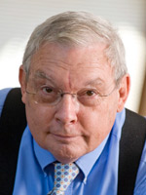
Agenda Setting Theory
Maxwell McCombs
UT Austin
Donald Shaw
UNC Chapel Hill

Slide 5
Agenda Setting
Media do not merely reflect reality; they filter and shape it
Media don’t tell us what to think, but what to think about
McCombs and Shaw first developed in 1972
News media have the ability to transfer salience of issues on news agenda to public agenda
News/media agenda: Pattern of news coverage across major print and broadcast media as measured by prominence and length of news stories
Public agenda: Most important public issues as measured by public opinion surveys

Slide 6
Agenda Setting Theory
What are you most concerned about these days?
What are the two or three main things you think the government should concentrate on?
Foreign policy
Law and order
Fiscal policy
Public welfare
Civil rights
Independent variable: The news media’s agenda of issues
Dependent variable: The public’s agenda of issues
Confounding variables: ?

Slide 7
Agenda Setting Theory
CAVEATS
News media are just one of many influences setting a national agenda. Different issues can be moved onto, off of, up or down the agenda by different factors, events, and forces.
The national agenda is short. Only three issues garner a national agenda status at any one time. If a new issue appears on that national agenda, an issue is dropped.

Slide 8
Agenda Setting Theory
LEVELS
Agenda Setting I
Agenda Setting II
Agenda Setting III
The first level has to do with issue or attribute salience.
The second attempts to measure the influence of the news agenda on the public by measuring salience.
The third posits that the salience of bundled relationships can and is transferred from news media to the public, a theory that presents news media as being an important part of an associative network of memory, cognitive mapping, and spreading activation. >>See the diagram on p. 107, which was created from the data gathered as part of a content analysis, p. 106.

Slide 9
Agenda Setting Theory
Who sets this media news agenda?
Research identified four sources:
Exchanges with sources for stories
Daily interactions among news organizations themselves
Journalism’s norms and traditions (conflict, negative news)
Online social media trends

Slide 10
Agenda Setting II: Attributes (Framing Theory)
Framing theory looks at attribute agenda setting, or the impact of the news media agenda on the public agenda in terms of the salience of the attributes of these issues, such as race.
https://www.youtube.com/watch?v=SuwNCyYxxlA

Slide 11
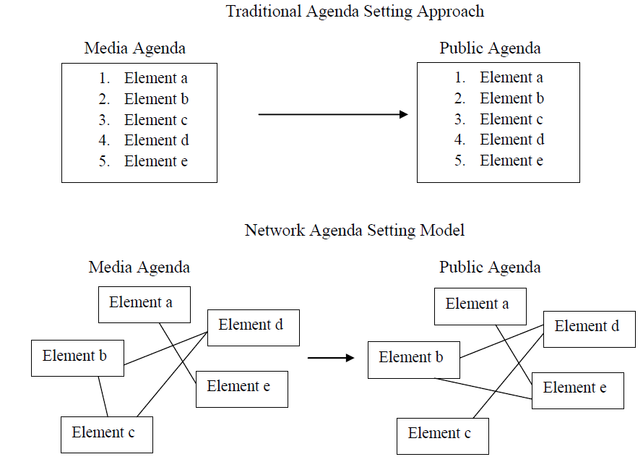
Agenda Setting III: Network (Cognitive Mapping)

Slide 12
Agenda Setting Theory
METHODS
Surveys and content analyses
Panel studies
Time-series analysis
Longitudinal designs
By incorporating notions of collective memory, we’ve entered a whole new phase of agenda setting theory development.

Slide 13
Example: Shark attacks
The summer months in New York City are accompanied by seasonal traditions, such as ice cream trucks, heat waves — and the media hyped supposed threat of shark attacks.
New York’s last fatal shark attack occurred in 1878
Only 30 recorded attacks in the state since 1642
Less than half of those attacks were unprovoked.
Humans actually kill far more sharks, to the tune of 100 million since statistics began

