Slide 1
How to Conduct Research
COM 415, Willoughby

Slide 2
Today’s Agenda
What is research?
Quantitative
Qualitative

Slide 3
Communication Research Process
Communication scholars develop theories to explain what messages mean or how/why we create or respond to messages
Theories need to be tested or applied
Research is where we test or apply theories to reach specific conclusions

Slide 4
Communication Research Process
Starts with a research problem or question: what are you interested in learning more about? What puzzle is there to solve? What can you not explain through simple observation?
  Just because something hasn’t been studied before doesn’t mean its worth studying
  A problem or question that has a yes/no answer isn’t suitable for scholarly research
Research problem – identifies problem that needs to be solved or issue that needs to be addressed through research (i.e. “Scandals often doom politicians’ careers.”)
Research question – what you want to find out through communication research (ex. ”What strategies can help politicians regain credibility after a scandal?”)

Slide 5
Communication Research Process
Read through scholarly literature related to topic area
Based on literature, narrow or refine your research question
Choose a methodology that will help you best answer your research question
Gather your data
Analyze your results
Present your findings
https://www.youtube.com/watch?v=3KGXV0dzoQ0&list=PLcctJF2VOeZA9LpsddH-8JITQesSwCPcW&index=2&t=26s

Slide 6
What are research methods?
Methodology – how you go about answering your research question, steps you will take in conducting research
Method selected should help you answer your question
  Ex. ”What strategies can help politicians regain credibility after a scandal?
    If case where politician’s credibility was restored through an apology, might choose textual analysis to look at content of a politician’s apology
    If want to test potential strategies for apologizing, might choose survey or focus group to see how people respond to hypothetical apologies

Slide 7
Quantitative Research
“It is the job of the quantitative researcher to employ statistical tools that will summarize trends and…predict the likelihood of event occurrences” Bashi, 2004
Tends to be explanatory and predictive - interested in cause/effect

Slide 8

Measurement – Key Terms
Accurate measurement is vital to sound research – garbage in, garbage out
Operationalize – define variables to study
Code – assigned numbers to variables according to a system
Reliability - Measures same construct every time, consistency
Validity - Degree to which a measure actually measures what is claimed, accuracy

Slide 9
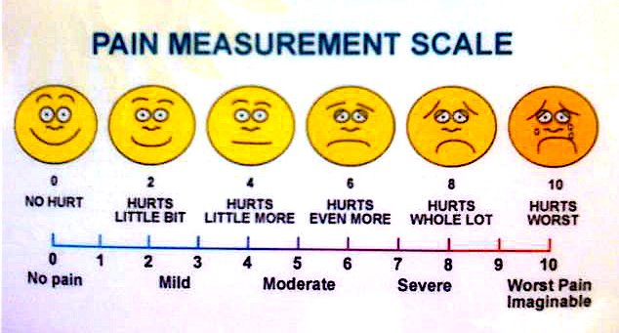
Surveys
A method for studying attitudes, opinions and behaviors of a sample population
Ex: Academic memorable message of college students; Non-white adult opinions about Trump; Netflix viewing patterns of moms with kids still in school
Uses questionnaires or interviews to discover descriptive characteristics of phenomena, describe patterns of behavior
Informed consent – all study participants MUST give informed consent on whether they will participate or not
Surveys DO NOT establish cause effect relationships directly

Slide 10
What’s the problem with this question?

Slide 11
Design your own!
Let’s say you want to design a survey to understand your audience’s breakfast habits
Group up!
Write 3 questions

Slide 12
Content Analysis
A method for studying the content of media
Sample consists of a type of media rather than people
Ex: Breast Cancer Websites, newspaper articles challenging climate change, sitcom episodes featuring gun violence
Typically combines qualitative and quantitative – used when we want to analyze a lot of information in a text thoroughly and efficiently
If deciding between textual analysis and content analysis, ask yourself ”Can I better answer my research question by categorizing and counting my data?

Slide 13
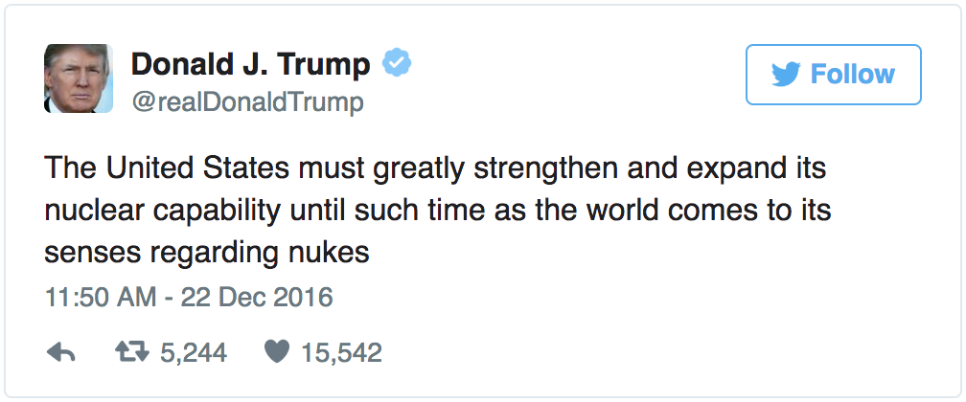
Codebook
Case: (Insert #)
Tweet: (Insert tweet, open-ended)
Hashtags: (Insert tweet, open-ended)
HashtagNumber: How many hashtags were used? (Insert #)
Favorite: How many people hit favorite on the tweet? (Insert #)
Retweet: How many people retweeted the tweet? (Insert #)
Tweeter: Who posted the tweet? 1. Individual 2. Organization 3. Pseudonym
Sex: Was the poster male or female? 1. Male 2. Female 3. N/A

Slide 14
Qualitative Research Methods
More interpretive than objective
“If you’ve ever wished you could truly capture and describe the essence of an experience you have had, you understand the goal of qualitative research methods.” - Paynton and Hahn
Data is typically open-ended, seeks to answer the what, how, and why of communication
Does not include statistically analyzing data
Interested in understanding the subjective lived-experience of those they study - in other words, how can we come to a more rich understanding of how people communicate?

Slide 15
Types of Qualitative Research
People or behavior-oriented methods
  Interviewing – in-depth, one-on-one questioning that helps to answer why or how someone feels/behaves a certain way https://www.youtube.com/watch?v=litXW91UauE
  Focus groups – meet with groups to understand attitudes and behaviors https://www.youtube.com/watch?v=ng8SnDIre4o
Observational research – helps to understand culture/community at large
  Ethnography – places research in midst of subjects being studied, helps answer what kinds of communication behaviors exist in particular cultures https://www.youtube.com/watch?v=2wZuL1oqOPw
  Participant observation - gives insider’s perspective, researcher is part of group being observed
  Unobtrusive observation – study group without being present around group ex. studying how graffiti left on bathroom walls changes over time and what they means about our communicative behaviors

Slide 16
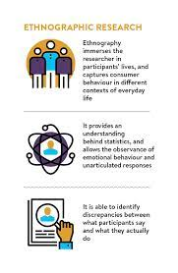
Types of Qualitative Research
Observational research – helps to understand culture/community at large
  Ethnography – places research in midst of subjects being studied, helps answer what kinds of communication behaviors exist in particular cultures https://www.youtube.com/watch?v=vs8au2G0cb4
  Participant observation - gives insider’s perspective, researcher is part of group being observed

Slide 17
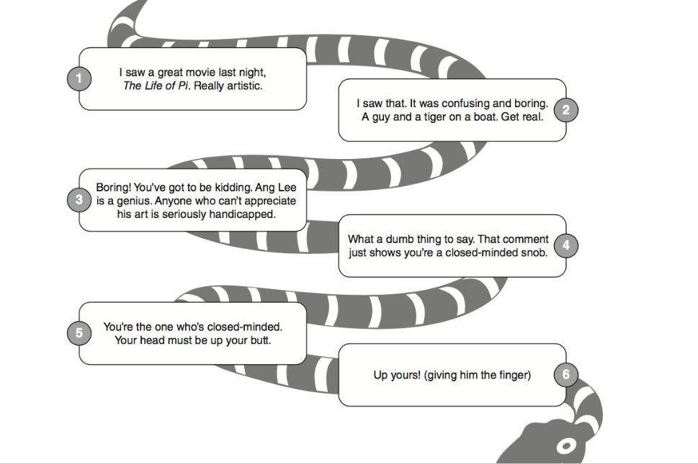
Types of Qualitative Research
Textual analysis – looks at a message/text
  Rhetorical criticism – describes, analyzes, interprets, or evaluates persuasive force of messages embedded in text
  Critical/cultural analysis – examines and exposes how power structures within a culture are reinforced or subverted through a text
  Conversation/interaction analysis – examines structure, messages, functions, rules, and content of people’s conversations

