Slide 1
Burkean Theory
COM 415 | Dr. Carroll

Slide 2
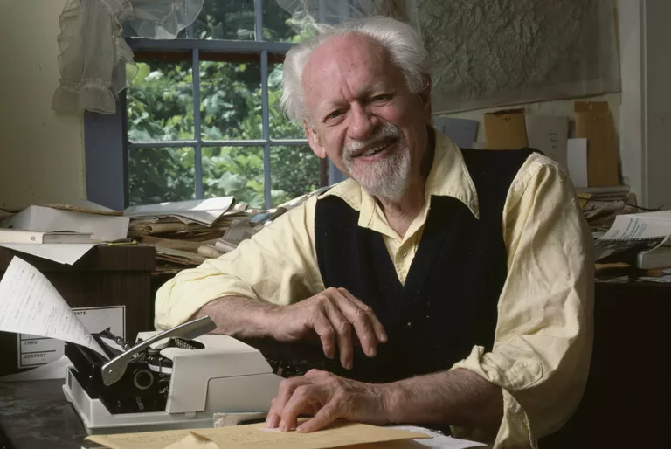
Kenneth Burke
American literary critic (1897-1993)
Social constructionist
Rejected objectivity
Language is a form of action rather than knowledge
Action vs. motion
motion – motives derived from animality (food, shelter, etc.)
action – motives originating in symbolicity; desires arise from symbol systems (education, politics, religion, etc.)
Symbolic action is grounded in non-symbolic motion

Slide 3
“Man is the symbol-using inventor of the negative separated from his natural condition by instruments of his own making goaded by the spirit of hierarchy and rotten with perfection.”
Kenneth Burke, Language as Symbolic Action, 1966

Slide 4
Identification
common ground between speaker and audience
identification replaces persuasion
pathos over logos
3 ways to use
means to an end
to create antithesis against common foe
unconsciously and/or out of the conscious awareness of sender and/or receiver

Slide 5
Let’s Analyze It!
Police Chief C. J. Davis (Memphis): https://www.youtube.com/watch?v=jpD2FDjBBr8
Tyre Nichols died three days after being beaten by Memphis police
How does the speaker attempt to build identification with audience?

Slide 6
Guilt-Redemption Cycle
Quest for redemption is basic plot of human drama, even if rhetor is unaware
We communicate to purge ourselves of guilt
Three sources of guilt:
The Negative: Language allows for rules, morals, etc. that surround us and we can’t escape violating
The Principle of Perfection: Language allows us to “imagine” the ideal (should)
The Principle of Hierarchy: Structure society with competing class and group distinctions

Slide 7
Guilt-Purification- Redemption
Hierarchical principle – we organize our lives according to hierarchical divisions
Constant struggle to change position and climb ladder
Mystification – we don’t know what it’s really like at other levels of hierarchy
Go through GPR cycle while trying to climb ladder
Guilt – failure to fulfill verbal covenants; results from framing and verbal reaction to act rather than act itself; uncomfortable feeling

Slide 8
Guilt-Redemption Cycle
Getting rid of guilt is ultimate motive for public rhetoric
People object to functions and relationships imposed by hierarchy
Consequently feel guilty, as if they have failed
Purification - how rhetors offload guilt
Mortification – confession of guilt and request for forgiveness
Victimization – naming external enemy as source of ills, scapegoating
Redemption – once purified, people re-establish themselves in given hierarchy

