Slide 1
Media Effects
Willoughby, COM 415

Slide 2
How do media affect us?
Mass media affect our thoughts, attitudes, and behavior
Katz ”Communication research is about effect”
Wide range of theories to explain how we use media and how media impact us
Early theories
Uses and Gratifications
Cultivation
Priming/Framing
Agenda Setting

Slide 3
Magic Bullet Theory
Also known as Hypodermic Needle Model
Harold Lasswell first published in 1930
Media’s message fired from magic gun into audience’s head
Assumes audience is passive and singular
Claims mass media had a direct, immediate and powerful effect on its audiences
Popular from 1930—1950s to describe media influence
Radio and television rose in popularity
Advertising and propaganda were becoming mainstream
Hitler used mass media in 1930s to unify Germans

Slide 4
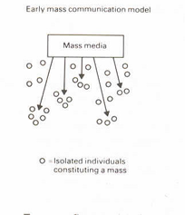
Magic Bullet Theory
Example: Orson Welles War of the Worlds
Radio broadcast of H.G. Wells alien invasion story
Approx. 12 million people in U.S. heard broadcast, and 1 million thought invasion was real
Made public seem gullible and easily influenced by mass media
https://www.youtube.com/watch?v=a-toj0weAEM&feature=youtu.be

Slide 5
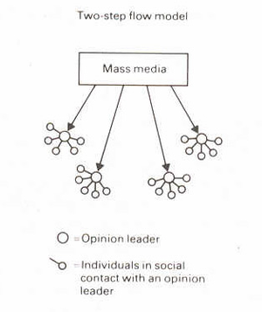
Two-Step Flow Model
Elihu Katz and Paul Lazarsfeld, 1955
More likely to be influenced by other people (opinion leaders) than media
First stage: direct transmission of information to small group of people who stay informed
Second stage: opinion leaders pass on and interpret messages to others in face-to-face discussion

Slide 6
Two-Step Flow Model
https://www.youtube.com/watch?v=csGHExeP3uA
Revised two-step theory of media influence
Transmission of information to mass audience
Validation of message by people the viewer respects

Slide 7
Who are some opinion leaders that influence us today?

Slide 8
Excitation Transfer Theory
Theory from social psychology used by media effects scholars
Dolf Zillman introduced in 1960s
the physiological dimension of emotional response to an initial stimulus or event persists/lingers beyond immediate exposure to that stimulus
i.e. Emotional reactions like fear, anger, joy, and lust generate heightened arousal that takes a while to dissipate after media exposure
Leftover excitation amplifies moods we feel afterward

Slide 9
COPS
If any of these theories are true, what does this say about the impact of COPS on how we think about policing?
Which theory do you think best describes how COPS affects us?

