Slide 1
Qualitative Research Methods
COM 415, Willoughby

Slide 2
Qualitative Research Methods
More interpretive than objective
“If you’ve ever wished you could truly capture and describe the essence of an experience you have had, you understand the goal of qualitative research methods.” - Paynton and Hahn
Data is typically open-ended, seeks to answer the what, how, and why of communication
Does not include statistically analyzing data
Interested in understanding the subjective lived-experience of those they study - in other words, how can we come to a more rich understanding of how people communicate?

Slide 3
Types of Qualitative Research
People or behavior-oriented methods
Interviewing – in-depth, one-on-one questioning that helps to answer why or how someone feels/behaves a certain way https://www.youtube.com/watch?v=litXW91UauE
Focus groups – meet with groups to understand attitudes and behaviors https://www.youtube.com/watch?v=ng8SnDIre4o
Observational research – helps to understand culture/community at large
Ethnography – places research in midst of subjects being studied, helps answer what kinds of communication behaviors exist in particular cultures https://www.youtube.com/watch?v=2wZuL1oqOPw
Participant observation - gives insider’s perspective, researcher is part of group being observed
Unobtrusive observation – study group without being present around group ex. studying how graffiti left on bathroom walls changes over time and what they means about our communicative behaviors

Slide 4
Types of Qualitative Research
Observational research – helps to understand culture/community at large
Ethnography – places research in midst of subjects being studied, helps answer what kinds of communication behaviors exist in particular cultures https://www.youtube.com/watch?v=vs8au2G0cb4
Participant observation - gives insider’s perspective, researcher is part of group being observed
Unobtrusive observation – study group without being present around group ex. studying how graffiti left on bathroom walls changes over time and what they means about our communicative behaviors

Slide 5
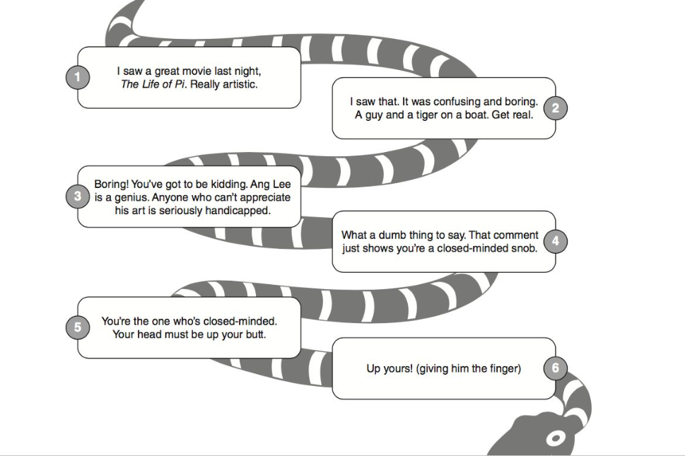
Types of Qualitative Research
Textual analysis – looks at a message/text
Rhetorical criticism – describes, analyzes, interprets, or evaluates persuasive force of messages embedded in text
Critical/cultural analysis – examines and exposes how power structures within a culture are reinforced or subverted through a text
Conversation/interaction analysis – examines structure, messages, functions, rules, and content of people’s conversations

Slide 6
Sampling
Who/what are you going to study to gather your data?
Qualitative typically uses purposeful sampling – select the people or texts that will help you best answer your research question
If dealing with people, ask
How will I recruit people to participate in my sample?
How will I collect data from people in this sample?
How many people should I include in my sample? (want to hit saturation point)
Focus group – 6-8 in each, multiple focus groups result in better data
Ethnography – 30+ people
Interviews – 5-25 people
If dealing with texts, ask
What text(s) should I analyze as part of my sample?
How many texts should I analyze to best answer my research question?
What type of data will I collect from this text?

Slide 7
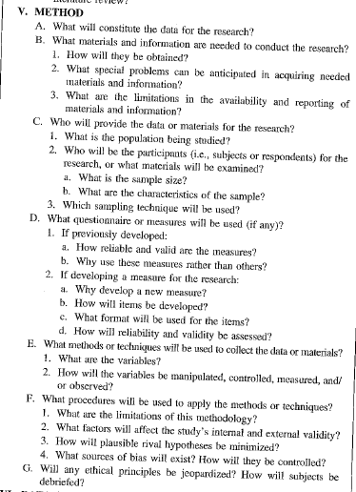
Writing About Methods

Slide 8
Activity
Break into three groups
You will be assigned a topic area to prepare a hypothetical qualitative research project on
For your topic, you need to come up with the following:
Basic research question (what do you want to find out through this research?)
Method you would use to conduct this research
Sample you would use to conduct this research
Example
Topic area: comic books
Research question: How can comic books challenge racial inequality?
Method used: Critical/Cultural Analysis
Sample: The Destroyer comic book (Modern story of Frankenstein, but Dr. Frankenstein is black female who lost son to police brutality)
Notes:
Topic areas: Donald Trump, Facebook, Harry Potter

