Slide 1
Quantitative Research Methods
COM 415, Willoughby

Slide 2
Today’s Agenda
What is qualitative research?
Measurement
Content analysis
Surveys

Slide 3
Communication Research Process
Communication scholars develop theories to explain what messages mean or how/why we create or respond to messages
Theories need to be tested or applied
Research is where we test or apply theories to reach specific conclusions

Slide 4
Communication Research Process
Starts with a research problem or question: what are you interested in learning more about? What puzzle is there to solve? What can you not explain through simple observation?
  Just because something hasn’t been studied before doesn’t mean its worth studying
  A problem or question that has a yes/no answer isn’t suitable for scholarly research
Research problem – identifies problem that needs to be solved or issue that needs to be addressed through research (i.e. “Scandals often doom politicians’ careers.”)
Research question – what you want to find out through communication research (ex. ”What strategies can help politicians regain credibility after a scandal?”)

Slide 5
Communication Research Process
Read through scholarly literature related to topic area
Based on literature, narrow or refine your research question
Choose a methodology that will help you best answer your research question
Gather your data
Analyze your results
Present your findings

Slide 6
What are research methods?
Methodology – how you go about answering your research question, steps you will take in conducting research
Method selected should help you answer your question
  Ex. ”What strategies can help politicians regain credibility after a scandal?
    If case where politician’s credibility was restored through an apology, might choose textual analysis to look at content of a politician’s apology
    If want to test potential strategies for apologizing, might choose survey or focus group to see how people respond to hypothetical apologies

Slide 7
Quantitative Research
“It is the job of the quantitative researcher to employ statistical tools that will summarize trends and…predict the likelihood of event occurrences” Bashi, 2004
Tends to be explanatory and predictive - interested in cause/effect
Positivists/Post-Positivists
  Positivism – the philosophy that science is the only way to learn the truth
    Factual knowledge gained through observation is trustworthy
    Researchers exist independent of work and can be objective
  Post-positivism – recognizes that observation is fallible and subject to researcher biases
    Still believe in objective truth
    Believe that researchers should pursue objectivity by recognizing the effects of biases

Slide 8
Measurement
Accurate measurement is vital to sound research – garbage in, garbage out
Operationalize – define variables to study
Code – assigned numbers to variables according to a system

Slide 9
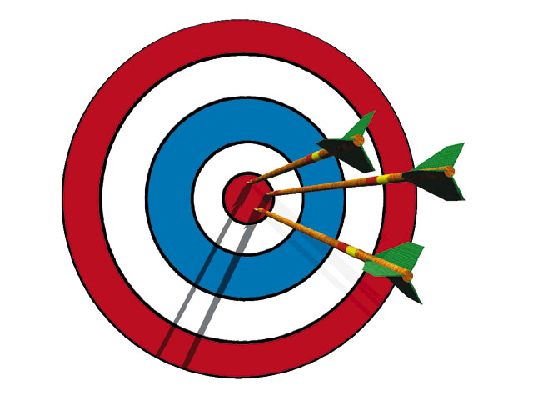
Validity and Reliability
  Reliability - Measures same construct every time
    Consistency
    Common ways to assess include test-retest reliability (repeating test to ensure repeated results) and intercoder reliability (ensuring different people rate things the same way)
  Validity - Degree to which a measure actually measures what is claimed
    Accuracy
    Assessed through reasoning of researcher (look through measurement items to argue that it measures what its claiming) or through external experts reviewing measure

Slide 10
Surveys
A method for studying attitudes, opinions and behaviors of a sample population
Ex: Academic memorable message of college students; Non-white adult opinions about Trump; Netflix viewing patterns of moms with kids still in school
Uses questionnaires or interviews to discover descriptive characteristics of phenomena, describe patterns of behavior
Surveys DO NOT establish cause effect relationships directly

Slide 11
Question Creation
Open ended questions – allows participants to respond in their own words; typically avoided in questionnaires or not used extensively
Closed ended questions – participants respond to fixed categories of answers
The way questions are written can drastically change results of survey - important to be clear and simple
  “How tall are you?” vs. “Please give your height in inches.”
  Avoid asking participants “Why?”

Slide 12
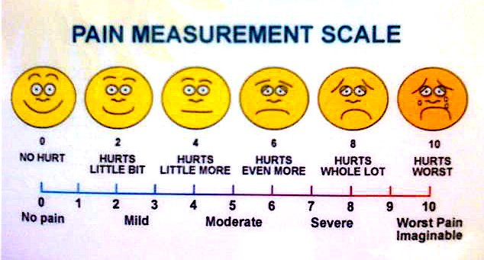
Types of Questions
Dichotomous
Multiple choice
Likert
Semantic differential
Rank-order
Fill in the blank
Questions aided by pictures

Slide 13
Let’s try it!

Slide 14
What’s the problem with this question?

Slide 15
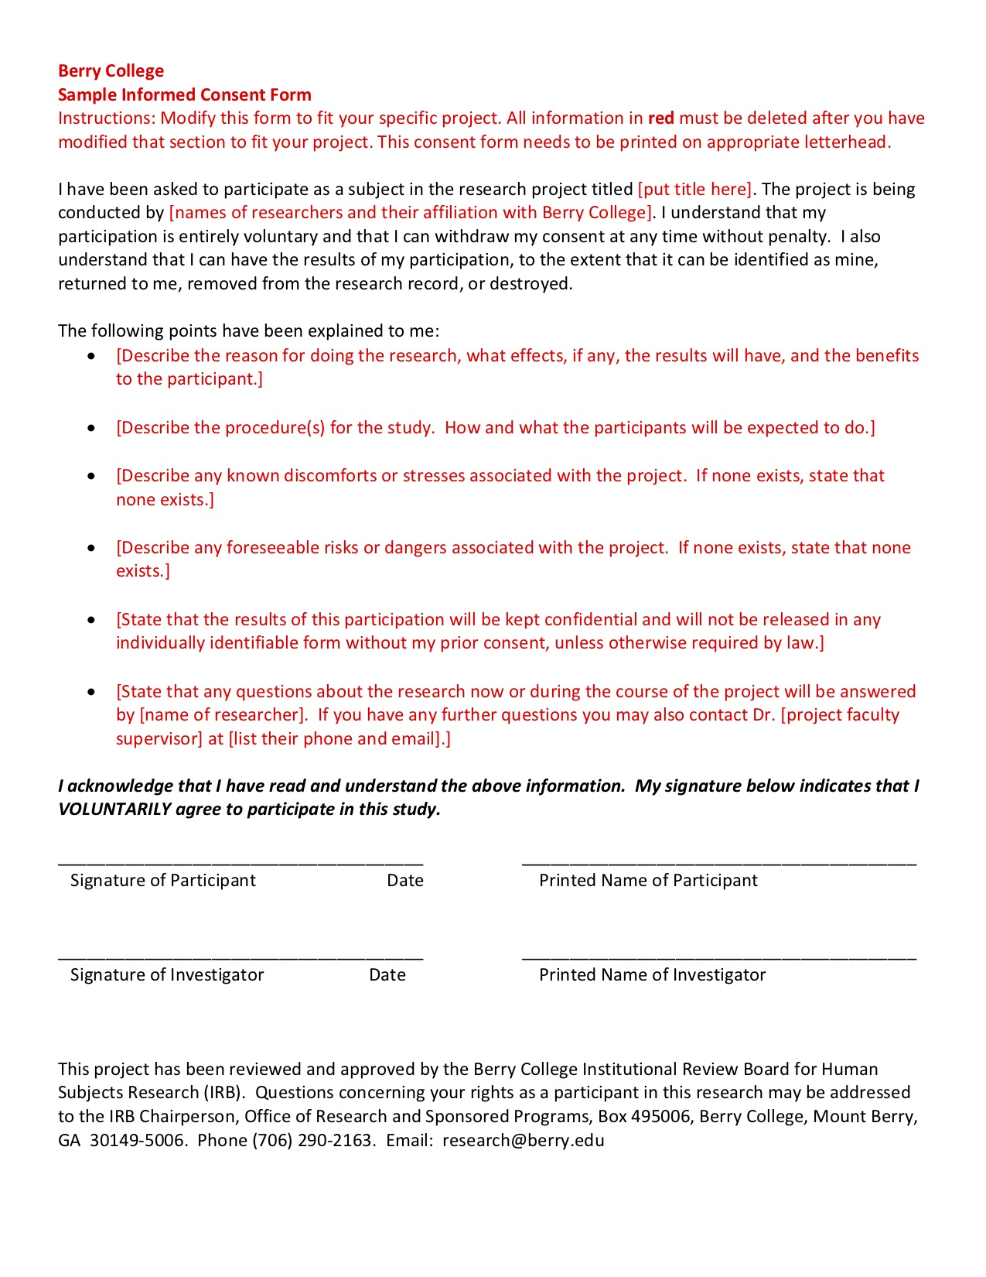
Survey Design
Informed consent – all study participants MUST give informed consent on whether they will participate or not
Instructions – include instructions that are clear, direct, and stand out
Question order – question should follow logical order that does not lead to bias

Slide 16
Design your own!
Let’s say you want to design a survey to understand your audience’s breakfast habits
Group up!
Write 3 questions

Slide 17
Content Analysis
A method for studying the content of media
Sample consists of a type of media rather than people
Ex: Breast Cancer Websites, newspaper articles challenging climate change, sitcom episodes featuring gun violence
Typically combines qualitative and quantitative – used when we want to analyze a lot of information in a text thoroughly and efficiently
If deciding between textual analysis and content analysis, ask yourself ”Can I better answer my research question by categorizing and counting my data?

Slide 18
Conducting a Content Analysis
Select your sample
  Twitter comments when using the search term “X”
Select parameters
  The most recent one-hundred tweets regarding “X” on Aug. 31, 2017
Select variables
  Post (open-ended); Hashtags (Open-ended); number of hashtags used; poster type (organization, individual, pseudonym); poster sex (Male, female, n/a)
Create codebook
Create data file
Code
Analyze

Slide 19
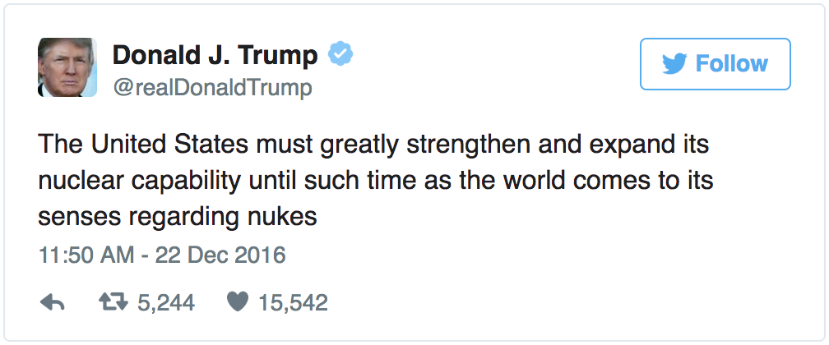
Codebook
Case: (Insert #)
Tweet: (Insert tweet, open-ended)
Hashtags: (Insert tweet, open-ended)
HashtagNumber: How many hashtags were used? (Insert #)
Favorite: How many people hit favorite on the tweet? (Insert #)
Retweet: How many people retweeted the tweet? (Insert #)
Tweeter: Who posted the tweet? 1. Individual 2. Organization 3. Pseudonym
Sex: Was the poster male or female? 1. Male 2. Female 3. N/A

