Slide 1
Quantitative Research

Slide 2
Agenda
Definitions
Content analysis
Surveys

Slide 3
Positivist/Post-Positive
Positivist social science researchers seek to understand the world through empirical, objective measures
  Gains confidence in a finding when multiple scientists reach the same conclusion
  Desire to generalize information
  Post-positivist
    …but this isn’t really possible
Notes:
I can’t really be objective

Slide 4
Quantitative Versus Qualitative
Qualitative
Quantitative
Think words, stories, observations
Open-ended, “rich” data
  Do not have set answers
Examples: focus groups, interviews, diary studies
Used by positivist, interpretive and critical scholars
Especially useful for formative, descriptive research
Think numbers, data
Closed-ended data
  Do have set, pre-determined answers
Can be generalizable, and establish relationships
Examples: Surveys, experiments, analytics
Used by positivist scholars
Especially useful for evaluative, predictive research
  Can also be used for formative, descriptive research
Notes:
At the end of the day it is about how you use your data. Not mutally exclusive – the best research is often thought to have both. Make sure to not oversimplify the work of interpretive and critical scholars – rather this class (and the text) is biased toward positivist research – you’d have to take a whole other class to dig into the other types of social science

Slide 5
Content Analysis
A method for studying the content of media
Sample consists of a type of media rather than people
  Ex: Breast Cancer Websites, newspaper articles challenging climate change, sitcom episodes featuring gun violence
Notes:
Is a quantitative methodology
However, like qualitative methods, content analysis is better for providing exploratory, descriptive data
Allows an understanding for the content of certain media
These assessments are heavily bound by time (media is constantly changing)
Is dependent on coding

Slide 6
Performing a content analysis
Select your sample
  Twitter comments when using the search term “X”
Select parameters
  The most recent one-hundred tweets regarding “X” on Aug. 31, 2017
Select variables
  Post (open-ended); Hashtags (Open-ended); number of hashtags used; poster type (organization, individual, pseudonym); poster sex (Male, female, n/a)
Create codebook
Create data file
Code
Analyze
Notes:
Parameters is where many students have have had trouble – be specific about what you’re going to

Slide 7
Codebook: Twitter Content Analysis
Case: (Insert #)
Tweet: (Insert tweet, open-ended)
Hashtags: (Insert tweet, open-ended)
HashtagNumber: How many hashtags were used? (Insert #)
Favorite: How many people hit favorite on the tweet? (Insert #)
Retweet: How many people retweeted the tweet? (Insert #)
Tweeter: Who posted the tweet? 1. Individual 2. Organization 3. Pseudonym
Sex: Was the poster male or female? 1. Male 2. Female 3. N/A
Notes:
After this I could code other things – positive or negative tweet about Taylor?
Explain coding – need agreement and statisticall reliablity – takes out percent chance

Slide 8
Survey
A method for studying attitudes, opinions and behaviors of a sample population
Ex: Academic memorable message of college students; Non-white adult opinions about Trump; Netflix viewing patterns of moms with kids still in school
Notes:
Note again: be specific with your final.

Slide 9

Validity and Reliability
Valid questions – measure their intended construct
Reliable questions – measure the same construct every time
Example construct: Attitude toward “Taylor Swift”
Notes:
Behaviors don’t necessarily indicate attitudes. Did you watch her video – yes, it’s a social phenomenon but I didn’t watch because I’m a fan. I just want to stay current (like marcus)

Slide 10
Question Creation
Two Main Types
Closed-Ended
  Questions with pre-set options
Open-Ended
  Questions without pre-set options
  Time consuming to analyze
  Frequently go unanswered on surveys
Notes:
Questions with no pre-set answers are interviews – qualitative, you’re going to have to do more coding

Slide 11
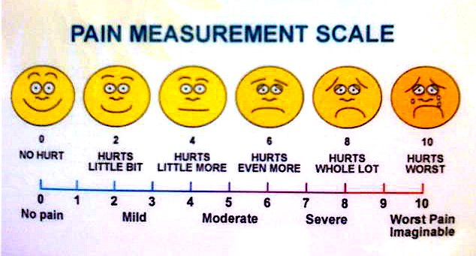
Types of Questions
Dichotomous
Multiple choice
Likert
Semantic differential
Rank-order
Fill in the blank
Questions aided by pictures
Notes:
Make them go through and do Taylor swift questions. Then rank – where are the most reliable? The most valid?

Slide 12
Question Creation
The way questions are written have been shown to dramatically change survey results
Guidelines:
  Be clear & Simple
    “How tall are you?” versus “Please give your height in inches”
    Consider the literacy level of your audience
    Don’t ask Participants “Why?” …

Slide 13
Question Creation
Guidelines:
  Don’t double-barrel questions
    “Do you like the taste and look of the product?”
    Ask one question at a time
  Avoid biased words or terms
    “How many years should individuals who commit the brutal act of rape serve?”
  Avoid leading questions
    “Tell me about the first time you cheated on a test.”
Notes:
Discuss survey here

Slide 14
Notes:
What’s wrong with this poll?
Sample
Questions

Slide 15
Survey Design
Introduction
  Discuss importance and relevance of study
    What’s in it for them?
Instructions
  Give instructions that are clear, simple and stand out
Question Order
  Start and end with easy questions
  Questions should follow a logical order that will not lead to bias
Notes:
Order bias:
Were you aware John McCain has a Black child?
How much do you like John McCain

Slide 16
Survey Design
Layout
  Use space effectively while still allowing for a clean look
Length
  Keep it as short as you can
Pre-Testing
  Get people to actually take the survey

Slide 17
Example Survey
Note those headers are variables
  Variables = constructs I wish to measure
  And should come from your theory

