Slide 1
Seven Traditions
COM 415, Willoughby

Slide 2
Communication Discipline
“Communication theory is the systematic and thoughtful response of communication scholars to questions posed as humans interact with one another” – Griffin
Practical discipline, but wide variety of theories
Robert Craig’s seven traditions in communication theory
Each tradition offers “distinct, alternative vocabularies”
Describe “different ways of conceptualizing communication problems and practices”

Slide 3
Seven Traditions
Socio-psychological
Cybernetic
Rhetorical
Semiotic
Socio-cultural
Critical
Phenomenological

Slide 4
Socio-psychological
Objective
Communication as interpersonal interaction and influence
Seek to discover communication truths through careful, systematic observation
Look at cause-effect relationships that can help predict future behavior
Remove personal bias – focus on what is, not what ought to be

Slide 5
Socio-psychological theories
Social Penetration
Social Judgment Theory
Elaboration Likelihood
Communication Accommodation
Uses and Gratifications
Agenda Setting

Slide 6
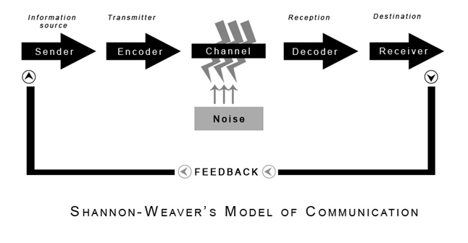
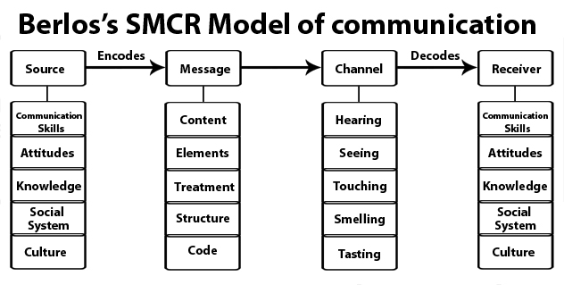
Cybernetic
Objective
Communication as system of information processing
Study of information processing, feedback, and control in communication systems
Focus on how system works and how it could improve

Slide 7
Rhetorical
Mostly interpretive, sometimes objective
Communication as artful persuasion
Traditionally focused on public address, but expanded in mid-to-late 1900s to include other artifacts (social movements, visuals, etc.)
How/why does this artifact persuade or not persuade?

Slide 8
Rhetorical Theories
Classical Theory
Burkean Theory
Narrative Theory
Symbolic Convergence
Critical Rhetoric

Slide 9
Semiotic
Mostly interpretive, sometimes objective
Communication as process of sharing meaning through signs
Words are arbitrary symbols that have no inherent meaning (meaning resides in people)
Trying to explain and reduce misunderstanding created by ambiguous symbols

Slide 10
Semiotic Theories
Semiotics
Saussure
Peirce
Barthes

Slide 11
Socio-Cultural
Interpretive
Communication as creation and enactment of social reality
Sapir- Whorf hypothesis – structure of a language shapes what people think and do in a culture; social construction of reality
“Persons in conversation co-construct their own social worlds” – Griffin
Helps us bridge gap between worlds, between “us” and “them”

Slide 12
Socio-cultural Theories
Postmodernism
Cultivation Theory

Slide 13
Critical
Interpretive
Communication as reflective challenge to unjust discourse
Frankfurt School – extension of Marxism
Focused on power and inequality
Provides critique of power structures in society (class, gender, race, etc.)
Sometimes looks at culture industries and how they reproduce dominant ideology of culture

Slide 14
Critical Theories
Critical Rhetoric
Postmodernism
Cultural Studies
Muted Group Theory
Standpoint Theory

Slide 15
Phenomenological
Interpretive
Communication as experience of self and others through dialogue
Analysis from standpoint of person living it
Focuses on stories/narratives of individuals and their own experience
Why is it so hard to establish and sustain authentic human relationships? How can this problem be overcome?

Slide 16
Phenomenological Theories
Muted Group Theory
Standpoint Theory

Slide 17
Blending of Traditions
Many scholars blend traditions together, combine more than one approach
Ex. critical rhetoric
Often overlap between traditions, especially when critical tradition is involved

