Slide 1
Uses and Grats
Dr. Carroll | COM 415

Slide 2
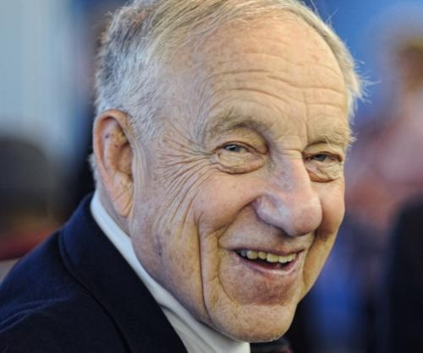
Uses and Gratifications
Elihu Katz
Sociologist and media scholar
Mentored by Paul Lazarsfeld
Known for work on two-step flow and uses and grats
Retired in 2014 from Annenberg School of Communication at University of Pennsylvania

Slide 3
Uses and Gratifications
Intro to the theory from the Media Insider:
https://www.youtube.com/watch?v=aopqPs7rb_Q
This body of work shifts conversation from “what does media do to us?” (Priming, Agenda-Setting, Framing) to “what do we do with media?”
We are in the general theory area of “Media Uses & Effects”
Attempts to (better) understand what motivates us to use media
We use media for particular purposes and to gratify various needs

Slide 4
Media uses and . . .
Social and psychological circumstances
Selective exposure and perception processes
Motivations
Group associations
Other sources of influence
Dispositions
Interpersonal communication
Opinion leadership

Slide 5
Research questions
Why do people pay attention to certain media fare?
What is the role of media and their content for their audiences?
What audience needs are and are not being met?
How active and/or goal-directed are audiences (users, viewers)?

Slide 6
The U&G Model katz, blumler, gurevitch
Uses & Grats research (1) seeks the social and psychological origins of needs that (2) generate expectations of the mass media or other sources, (3) which lead to differential patterns of media exposure (or engagement), (4) resulting in need gratifications and other consequences, perhaps mostly unintended ones.
The critique:
Lack of clarity of concepts
Focus on the individual

Slide 7
The U&G Model katz, blumler, gurevitch
Central tenets:
Communication behavior, including the selection and use of the media, is goal-directed, purposive, and motivated
Media users are variably active and initiate the selection and use of communication vehicles
Social and psychological factors guide, filter, or mediate behavior
Media compete with other forms of communication, such as interpersonal interaction for selection, attention, and use to gratify needs and wants
People rather than media are typically more influential in this process

Slide 8
Stable list for general media use
Typology of uses and gratifications
Passing time
Companionship
Escape
Enjoyment
Entertainment
Social interaction
Relaxation
Information
Excitement
What for you is a primary medium in terms of time you spend with it? What uses do you make of spending this time with this medium, and what gratifications do you think you enjoy because of it?

Slide 9
BUT . . . For specific media . . .
Unique motives
Horror films (thrill-seeking, erotica, sex substitution)
Sports (sense of achievement, tribal identity, aesthetics)
Political coverage (opinion leadership, identity, guidance)
Mysteries (puzzles, closure, vicariousness)
Motive typology research, therefore, is active
Also of help is looking at audience activity at different stages of use: before use (intentions, motives), during (involvement, attention, engagement, co-viewing), after (post-viewing discussions, sharing online, etc.)

Slide 10
Types of motives
Passive
Proactive
Diversionary
Utilitarian
Ritualistic
Instrumental

Slide 11
Parasocial Relationships
Sense of friendship or emotional attachment that develops between TV viewers and media personalities
Often used to refer to our one-sided “relationships” with celebrities
We see them in media and seek out information about them
We keep up with their lives
We feel like they impact us
Social media amplifies these effects
Sharing media content
Creating media content
Posting media content
Circles back to motives: socializing, status-seeking, etc.

Slide 12
What are some parasocial relationships That you’ve created?
Who’s your “best friend” on or via TV or Netflix or films?
Who do you feel you know best?

Slide 13
U&G: The Smartphone
Typology of uses and gratifications
Immediacy
Instrumentality
Mobility
Staying in touch
Planning the day
Accessing news
Cognitive, social, emotional, habitual needs-driven
What of gender differences?

Slide 14
Opportunities for research
Photo tagging
Music applications
AI
Co-viewing
Convenience
Social capital
Attention spans
Audience sub-sets, like health patients
Second screens
What can you think of?

Slide 15
Your turn
Using pages 147-9, group up to devise a U&G study that looks at some contemporary phenomenon
AI-generated ‘influencers’
Quizzes and puzzles, such as Wordle, Immaculate Grid
TikTok videos of . . . Fill in this blank
Other

