Slide 1
Kelsee’s Playlist
HON 201
4-19-21

Slide 2
The Structure
A look into how the past, present, and future impact each other in four aspects of my life
Family, Romantic Love, & Friends

Slide 3
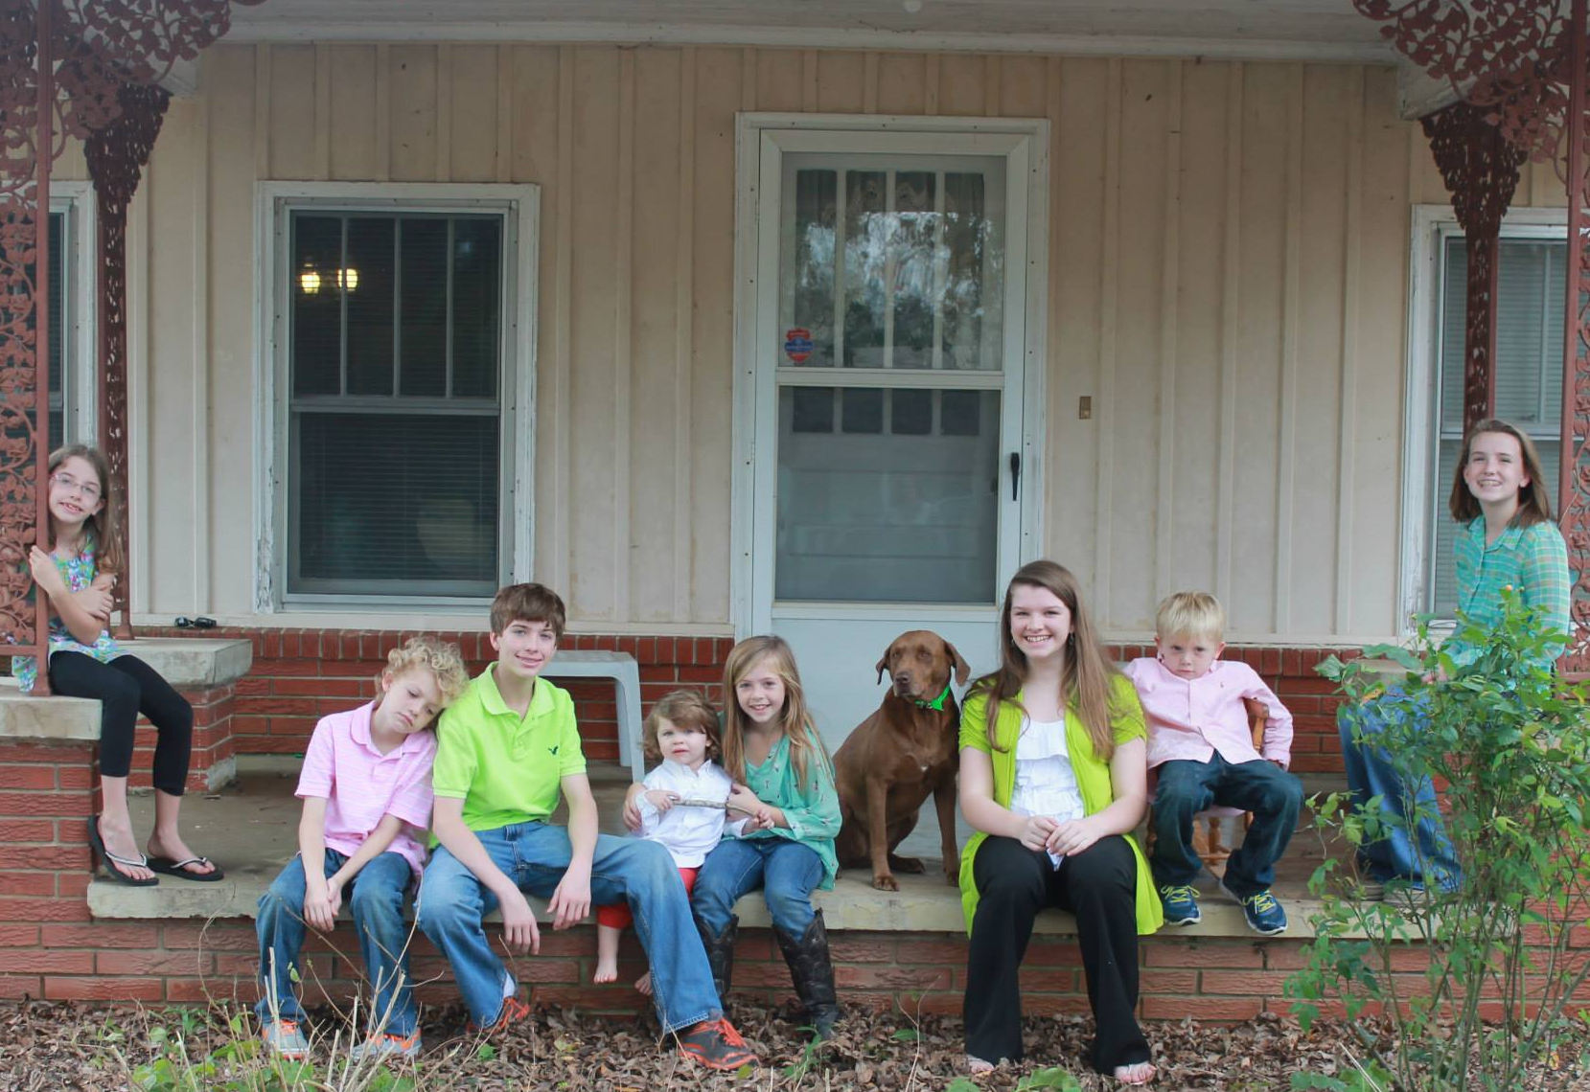
Family

Slide 4
Past
“Halcyon” by Blu Eyes
Synopsis: The narrator tells the story of her growing up with her family, particularly at her grandparent’s house off of Halcyon road. In the song, she reminisces on her childhood and how it has brought her to where she is today.
“It’s always been my home away from home
I grew up playing in the backyard
Swinging on the swing set
No idea what the real world was
Or How crazy it gets
Playin’ hide and seek
With my cousins in the trees
No clue then how much it all would mean to me”
Notes:
I relate to this song because it draws heavily on the impact of family, and I wouldn’t be where I am today without my family.
I also love how this song focuses on the impact of grandparents. When I was younger, I went to my grandparents’ house every afternoon after school so it was a big part of my life. While my grandparents are still living, I miss them everyday and I appreciate the nostalgia and sentiment in this song.

Slide 5
Present
“Half of My Hometown” by Kelsea Ballerini feat. Kenny Chesney
Synopsis: In the song, Ballerini talks about her hometown and the flaws, but she also recognizes that it made her what she is today, and she’ll always be half of her hometown.
Notes:
The negative aspects of my hometown, but it still made me what I am today
This is how I look back on them now

Slide 6
Future
“Christmas Tree Farm” by Taylor Swift
Synopsis: Taylor Swift grew up on a Christmas Tree Farm, and this song reflects that experience while also tying in her current partner.
The Christmas tree farm reminds her of home and she feels the same way that she felt on that farm when she’s with her partner.
Notes:
I love how this song ties in the past, present and future. The Christmas Tree farm represents swift’s past while tying in her present love and assuming that that love will be her future.

Slide 7
Friends

Slide 8
PASt
“Bad Habit” by Ben Platt
Synopsis: Ben Platt is reflecting on a previous relationship that was a bad habit. He does not want to acknowledge how much he relied on this person even though they were not good for him.
Notes:
In the past, I was drawn to people because they were close in proximity. This didn’t always lead to the best of friends. Of my high school friends, I only consistently talk to one of them. The song reflects how bad habits can form even if we may not realize it at the time.
It also reflects a deep part of me that relies heavily on others. I was shy as a child and as I have grown older, I have realized exactly how much I enjoy spending time with other people. While I may be an introvert, I love spending time with my friends and wanting to be there for them is one of my favorite parts of myself.

Slide 9
Present & future
“Long Live” by Taylor Swift
Synopsis: Swift talks about her past, and how much she treasures the moments that she had. She also acknowledges that the future might not be what she thinks it is, but she hopes that each person will include the other in their history when they share it with their children.
Notes:
Long Live
Taylor Swift concert before freshman year

Slide 10
Romantic relationships

Slide 11
PASt
“Happier for You” by Cam
Synopsis: Cam is reflecting on the fresh pain of her ex-husband remarrying to someone new.
“All the church bells ringin' It hurts me, I'm sorry But right now I'm just tryin' to make it through The day without cryin' My darlin', don't worry One day I'll be happier for you”
Notes:
My parents got divorced and then remarried which largely impacted my view of relationships
At the time, I couldn’t understand how someone could be married for 12 years and then just not be in love anymore. It’s more complicated than that, which I know now.
Today is my one day

Slide 12
Present
“All I Want” by Olivia Rodrigo
Synopsis: Olivia Rodrigo sings about how she knows what she wants out a relationship. She can’t understand why it never works out for her. She comes to the realization that she, all on her own, is enough.
“All I want is love that lasts Is all I want too much to ask Is it something wrong with me All I want is a good guy Are my expectations far too high Try my best but what can I say All I have is myself at the end of the day”
Notes:
My parents got divorced and then remarried which largely impacted my view of relationships
At the time, I couldn’t understand how someone could be married for 12 years and then just not be in love anymore. It’s more complicated than that, which I know now.
Today is my one day

Slide 13
Future
“The Good Ones” by Gabby Barrett
Synopsis: The singer shares about her current love and their relationship. She met her husband on American Idol, and the song tells the story about how she has found a good one.
“A love me like he should one Like he wrote the book one The kind you find when you don't even look one Anybody can be good once But he's good all the time He's one of the good ones And he's all mine He's one of the good ones”
Notes:
My parents got divorced and then remarried which largely impacted my view of relationships
At the time, I couldn’t understand how someone could be married for 12 years and then just not be in love anymore. It’s more complicated than that, which I know now.
Today is my one day

Slide 14
Honorable Mentions
“Stuck in My Head” by Blu Eyes
“Older” by Ben Platt
Notes:
My parents got divorced and then remarried which largely impacted my view of relationships
At the time, I couldn’t understand how someone could be married for 12 years and then just not be in love anymore. It’s more complicated than that, which I know now.
Today is my one day

